Slide 1
DL components
(complementary slides)
Activations and proper loss functions
Optimizers

Slide 2
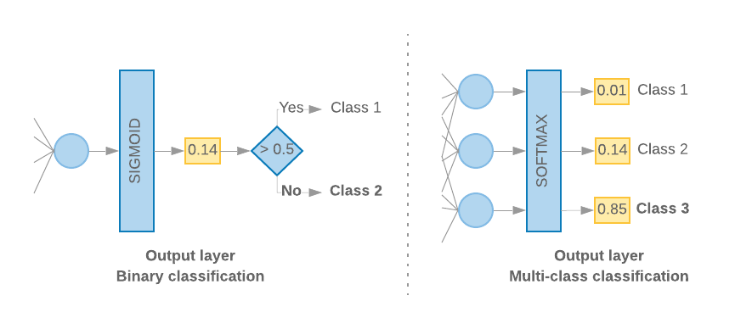
Activation: Sigmoid vs Softmax

Slide 3
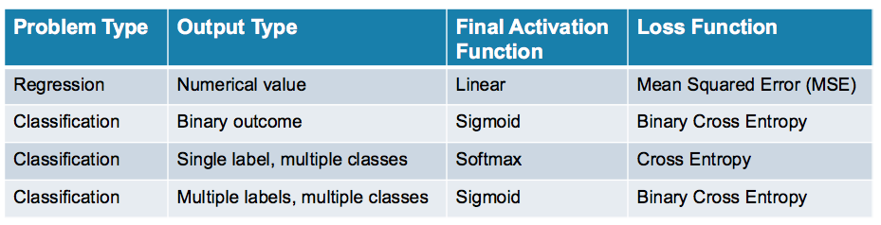
Typical NN architectures for different problems

Slide 4

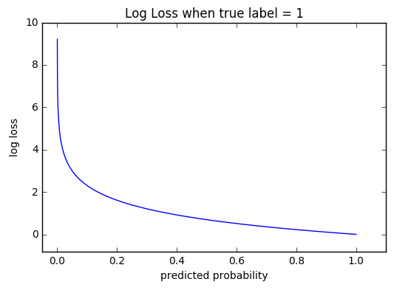
Logistic-Loss (cross-entropy) function for sigmoid\softmax activation layers
y’ = predicted (“probability”)
y = label
y | y’ | logLoss
0 | 0.9 | 2.3
0 | 0.1 | 0.1
1 | 0.9 | 0.1
1 | 0.1 | 2.3
Intuition: y y’ Big loss

Slide 5
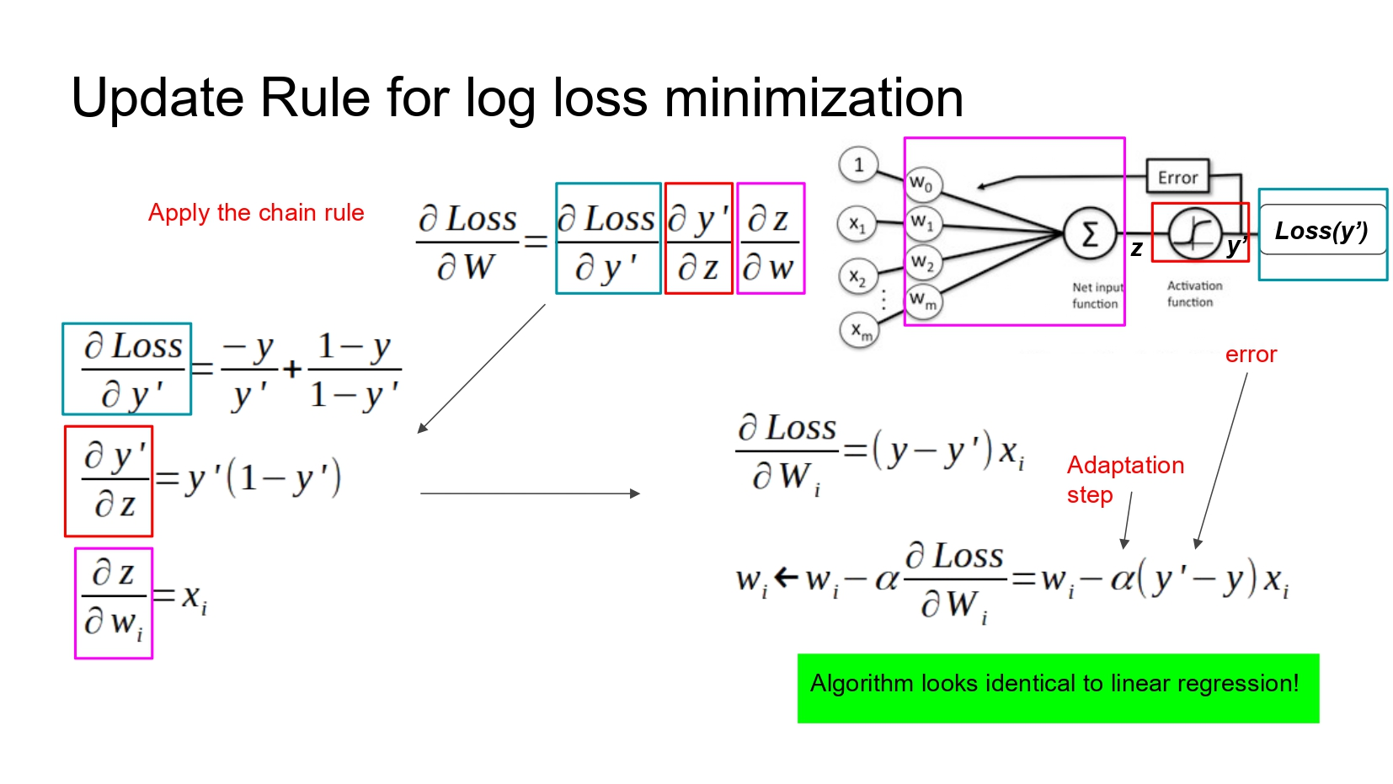

Slide 6
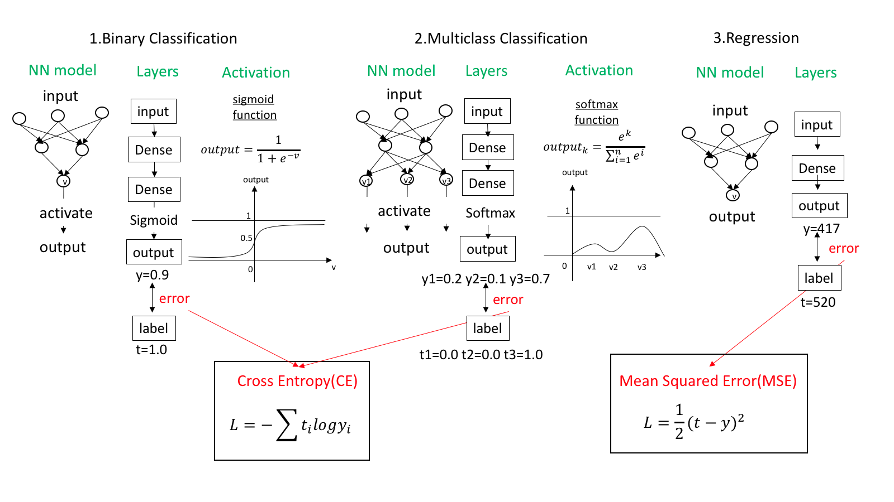

Slide 7
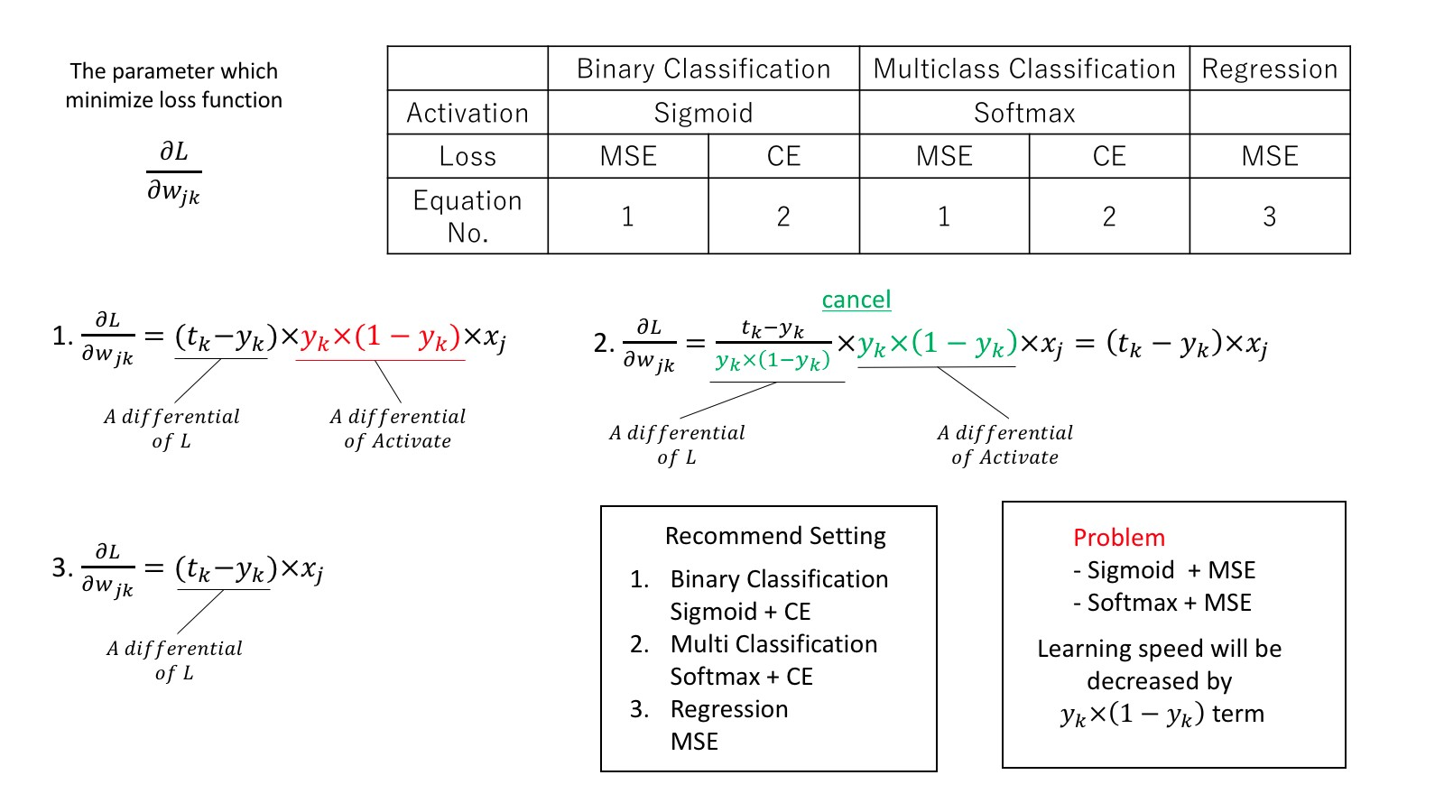

Slide 8


Slide 9
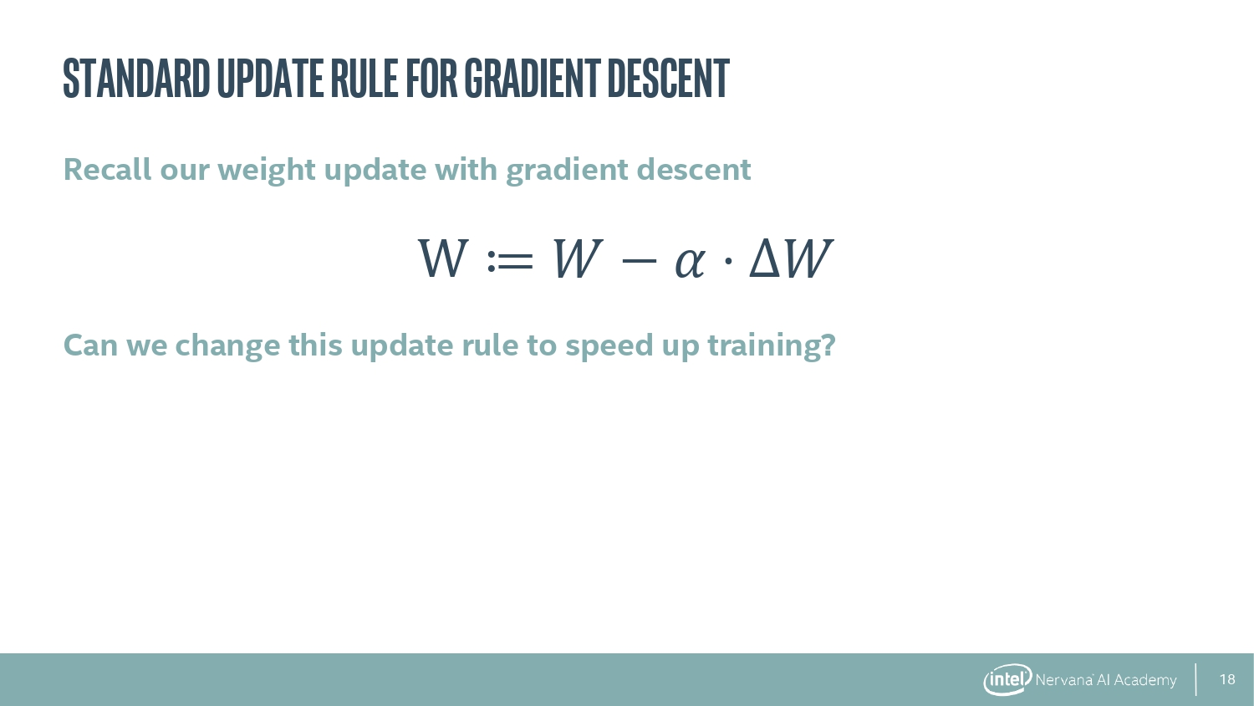

Slide 10
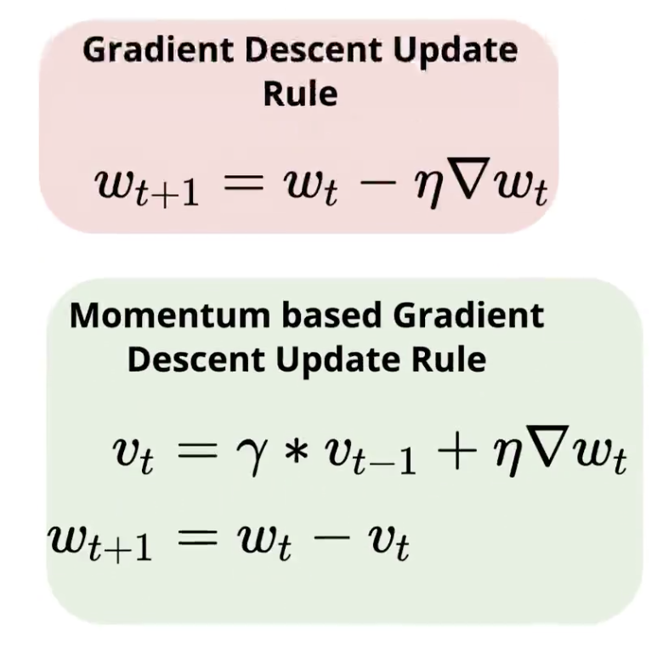
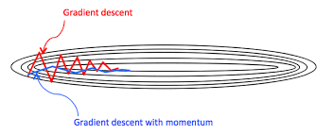
Momentum
Like a low-pass-filter: smooth the GDS trajectory

Slide 11
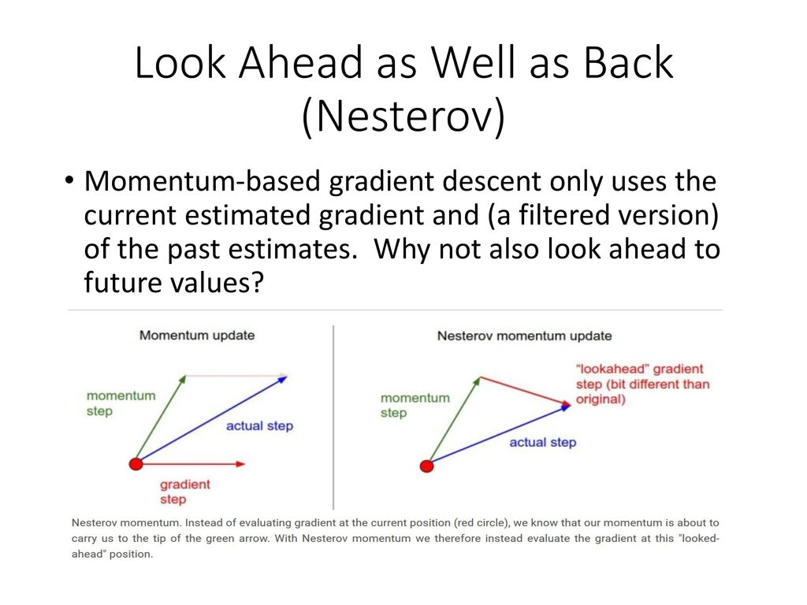
Nesterov

Slide 12
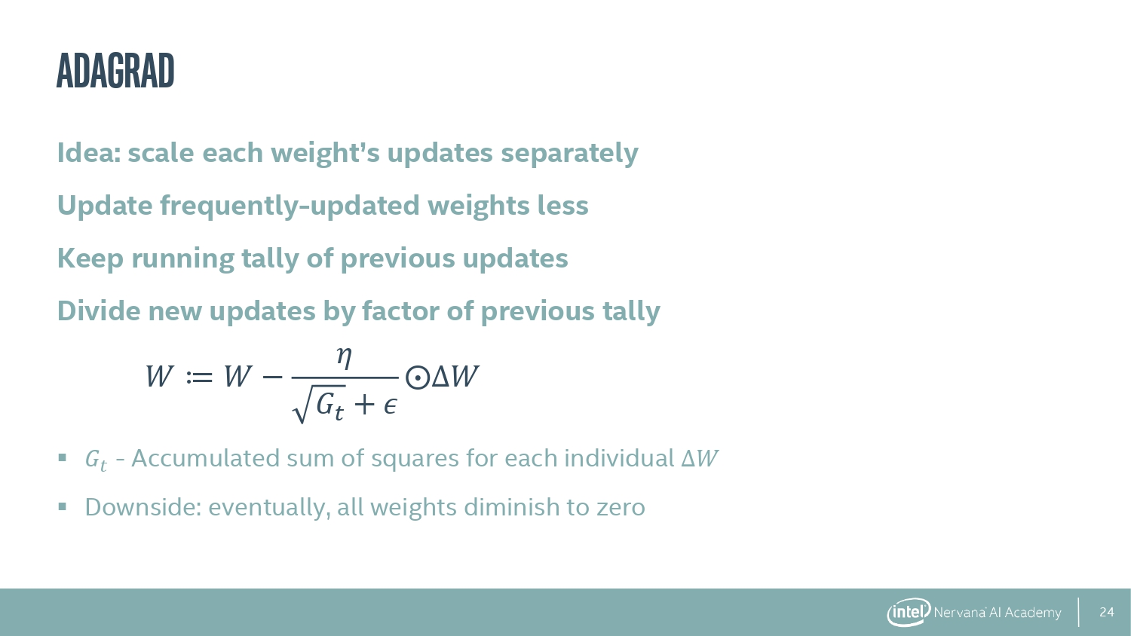

Slide 13
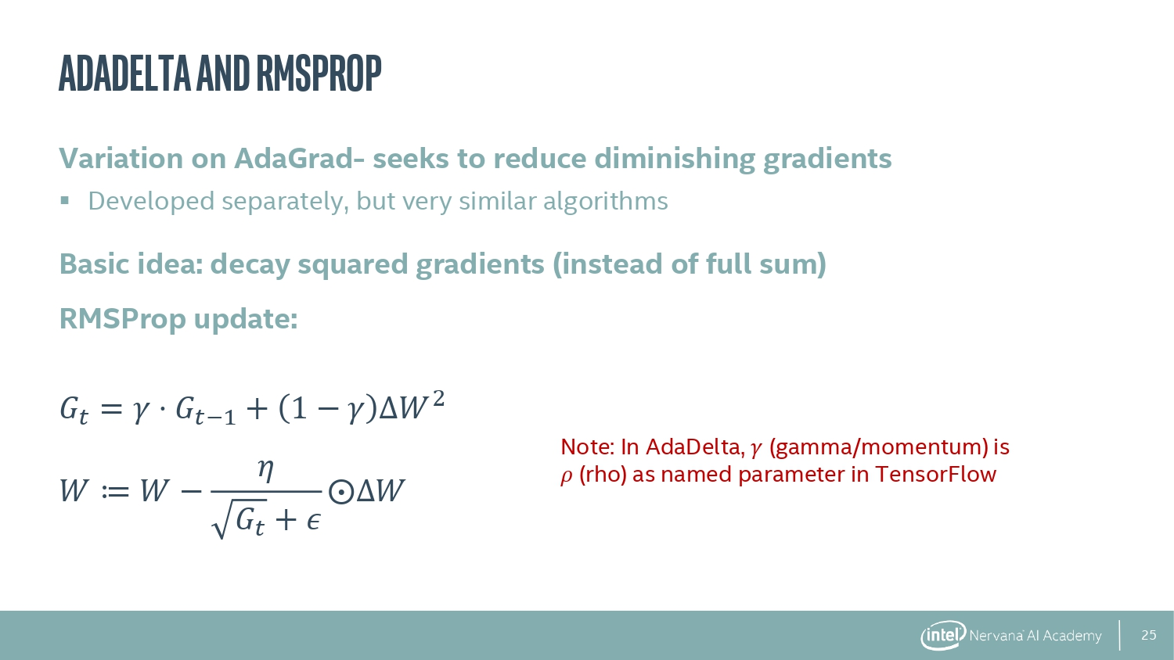

Slide 14
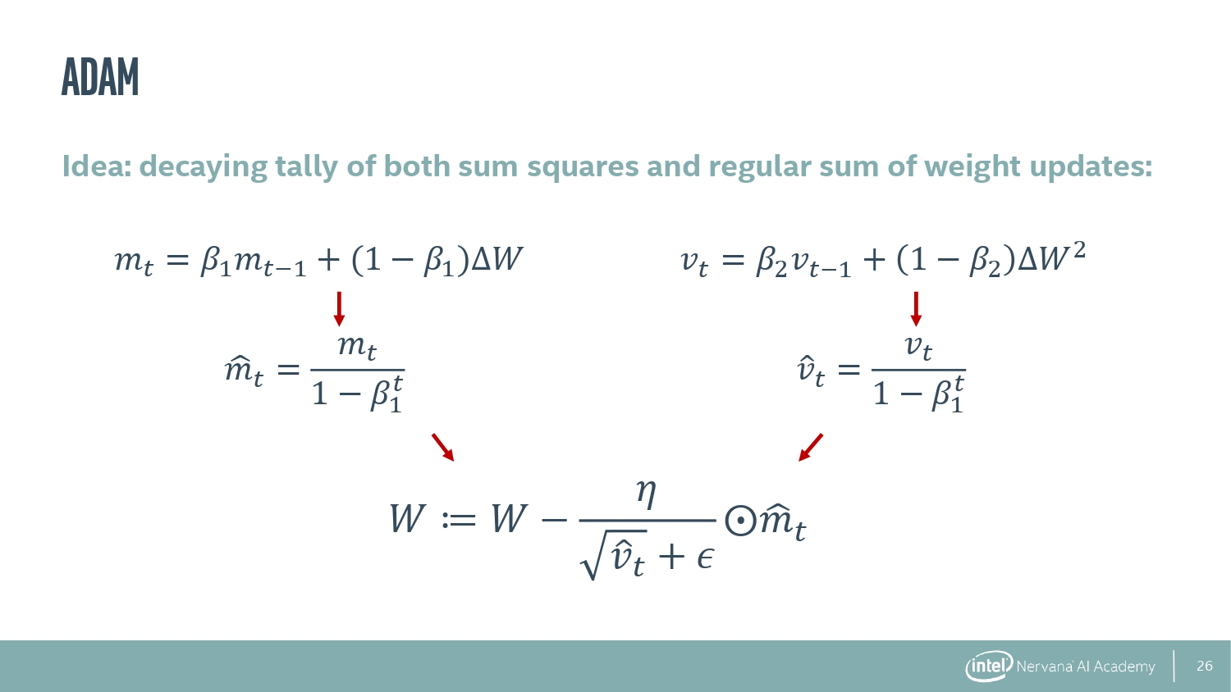

Slide 15
